Slide 1
HRRN CPU SCHEDULING
By
181FA04009-BVS Sai Krishna
181FA04027-kp Bhaskar
181fa04047-s venkat

Slide 2
OBJECTIVE
In general Shortest Job First scheduling algorithm gives the optimal average waiting time and turn around time but it has the problem of starvation. To prevent this problem we are using Highest Response Ratio Next (HRRN) CPU scheduling algorithm in which we use extra factor called Response Ratio through which we can avoid starvation.

Slide 3
Abstract
Highest Response Ratio Next (HRNN) is one of the most optimal scheduling algorithms. This is a non-preemptive algorithm in which, the scheduling is done on the basis of an extra parameter called Response Ratio. A Response Ratio is calculated for each of the available jobs and the Job with the highest response ratio is given priority over the others.

Slide 4
Introduction
The name itself states that we need to find the response ratio of all available processes and select the one with the highest Response Ratio. A process once selected will run till completion.

Slide 5
Response Ratio = (W+B)/B
Where W -> Waiting time
B -> Burst time of process
If we look at the formula, we will notice that the job with the shorter burst time will be given priority but it is also including an extra factor called waiting time.
Hence,
This algorithm not only favors shorter job but it also concern the waiting time of the longer jobs.

Slide 6
AlGorithm
Input the number of processes, their arrival times and burst times.
Sort them according to their arrival times.
At any given time calculate the response ratios and select the appropriate process to be scheduled.
Calculate the turn around time as completion time – arrival time.

Slide 7
5.Calculate the waiting time as turn around time – burst time.
6.Turn around time divided by the burst time gives the normalized turn around time.
7.Sum up the waiting and turn around times of all processes and divide by the number of processes to get the average waiting and turn around time.

Slide 8
ADvantages
It is Non-preemptive.
It prevents indefinite postponement (process of starvation).
It improves the performance of shortest job first scheduling.
It considers how long process has been waiting and increases its priority.
Its mode is non preemptive hence context switching is minimal in this algorithm.

Slide 9
disadvantages
Processes are scheduled by internal priority system because it does not support external priority system.

Slide 10

EXAMPLE

Slide 11

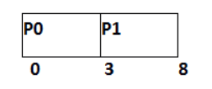
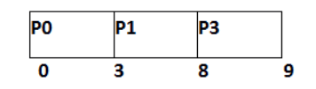

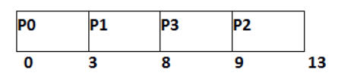

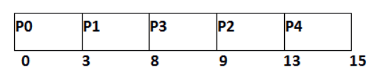

Slide 12
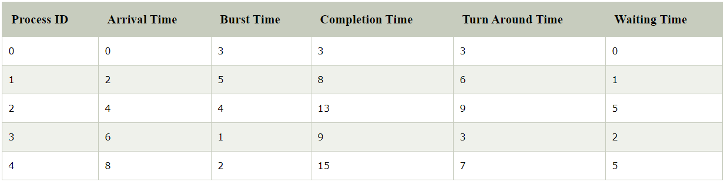
Average waiting time=2.6
Average turnaround time=5.6

Slide 13
THANK YOU

